Slide 1
Customer and BankAccount Trace
Group T01-03

Slide 2
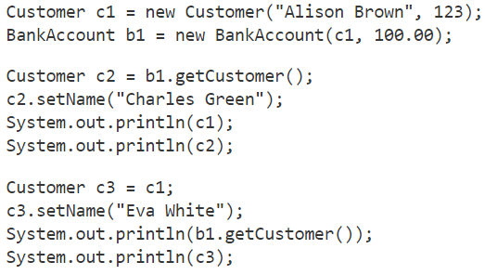
A new Customer object is created, where c1 is the instance variable that holds the memory address of this object.
The instance variables of c1 are initialized as follows:
Name = “Alison Brown”
customerID = 123

Slide 3
A new BankAccount object is created, where b1 is the instance that refers to this object.
The instance variables of b1 are initialized as follows:
accountHolder = c1
balance = 100.00
Note that one of b1’s variables is in fact the reference to our Customer object.

Slide 4
b1.getCustomer() will return the value of the Customer instance variable of b1. This variable holds the reference to the object created in line 1.
c2 now becomes the second instance variable (along with c1) that holds the memory address of this object.

Slide 5
The instance c2 calls the setter method to change the name variable, corresponding to the ONLY customer object we have created.
This means when values of both instances are printed, they are the same- the both refer to this single object.
Note that we see the formatted output of variables, as we made an override to the toString() method when the Customer class was defined.

Slide 6
A third reference is made to our Customer object.
As opposed to the assignment statement used when defining c2, this statement is more direct.
The line simply states that the instance variable c3 will refer to the same object as c1.

Slide 7
Just as we did for c2, in the second block of code; The instance c3 calls the setter method to change the name variable for the Customer object.
The first print statement displays the Customer object’s name, through an indirect path in which it goes through the BankAccount b1 rerference.
The second print statement directly refers to the name, through the overridden toString() method.
Any reference to the name variable of c1, c2, or c3; will have the same value.

